Slide 1




DOAS-HRA POLICY UNIT PRESENTS:
Onboarding - Statewide Substance Abuse Testing
Notes:
Hello and welcome to the Onboarding educational resource for Statewide Substance Abuse Testing. This training is being presented by the D.O.A.S. Policy Unit.

Slide 2

The Objectives
To provide an overview of the Statewide Substance Abuse Testing Program
To provide information on the signs and symptoms of alcohol misuse and prohibited drug use
To provide an understanding of HR’s role when there is a reasonable suspicion
To discuss some of the trends that may impact drug testing and the results
Notes:
The objectives that will be covered in the presentation are:
To provide an overview of the Statewide Substance Abuse Testing Program
To provide information on the signs and symptoms of alcohol misuse and prohibited drug use
To understand HR’s role when there is reasonable suspicion
To discuss some trends that may impact drug testing and the results

Slide 3
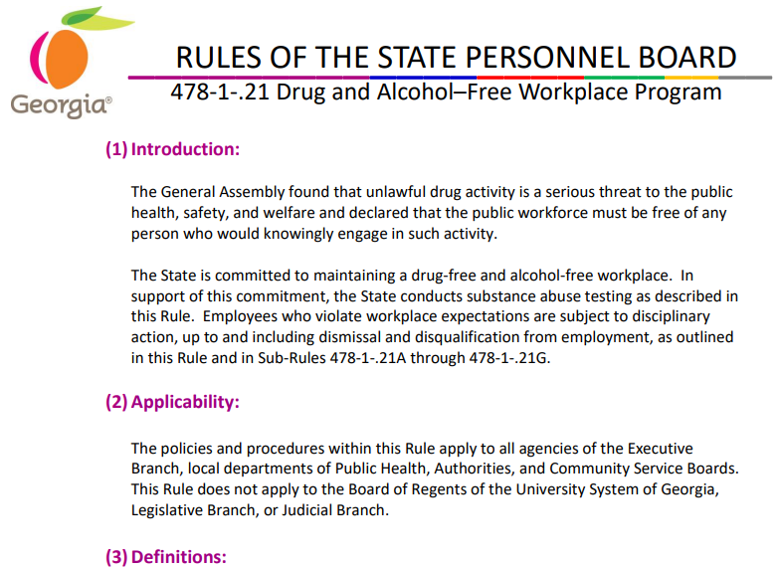

Click on the link: SPB Rule 21
Notes:
The slide on your screen shows the introductory text from State Personnel Board Rule 21. This rule sets statewide expectations for a drug and alcohol-free workplace and outlines the State’s testing programs. Beyond the sections of the rule that are showing on your screen, know that there is a wealth of other important information within the rule. To view the rule, please click on the link at the bottom of the slide.

Slide 4
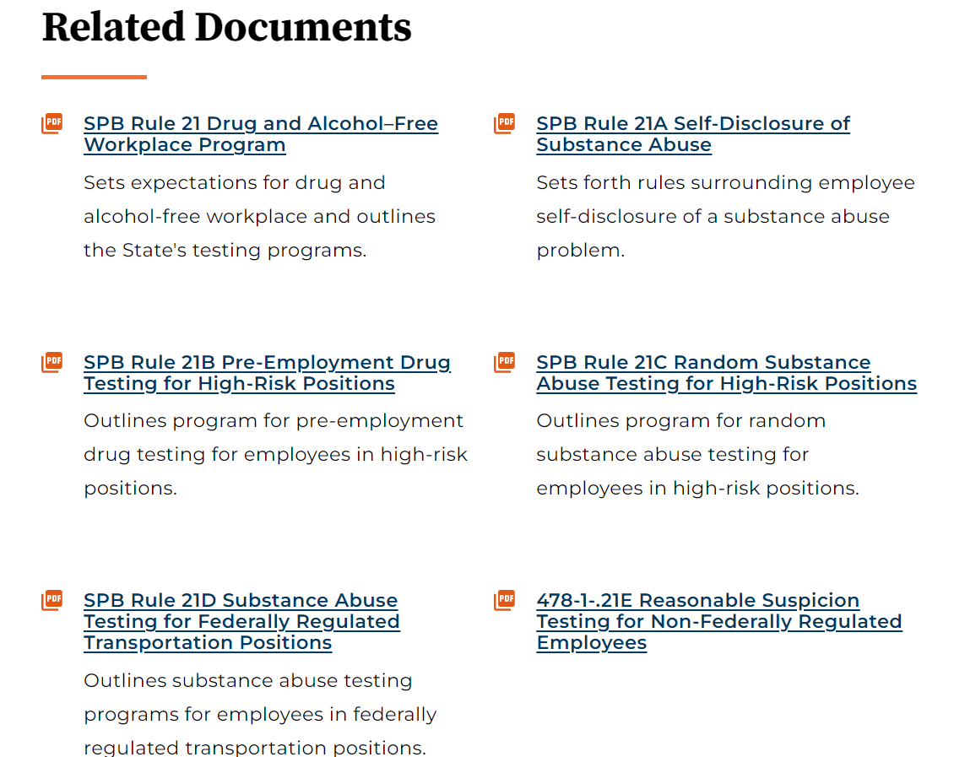
IMPLEMENTATION PLAN
SCHEDULE
PREPARE
DELIVER
September 23rd, 2025
ALIGN
September 9th, 2025
October 1st, 2025
September 1st, 2025
Notes:
This slide has a screenshot of the primary State Personnel Board Rule 21, which has nine subrules, some of which are shown on your screen.

Slide 5
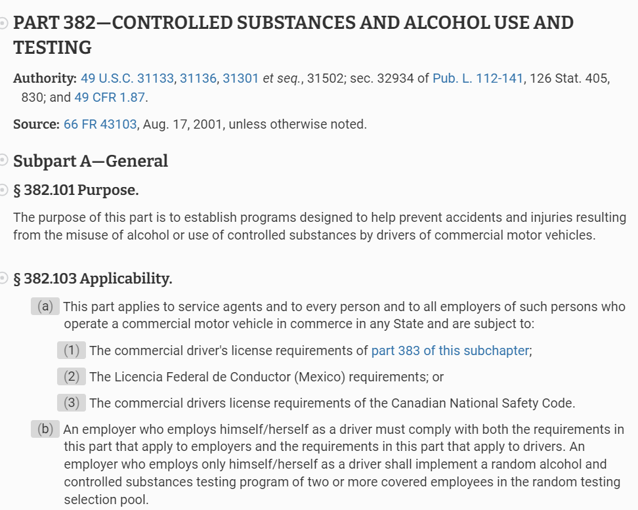
Federal Laws Governing Drug Testing
SCHEDULE
PREPARE
DELIVER
September 23rd, 2025
ALIGN
September 9th, 2025
October 1st, 2025
September 1st, 2025
Notes:
The state’s substance abuse testing program is not only guided by Rule 21 and it’s subrules, but also by various laws and regulations. The text on your screen provides information about federal laws that govern the State of Georgia’s drug and alcohol testing program.

Slide 6
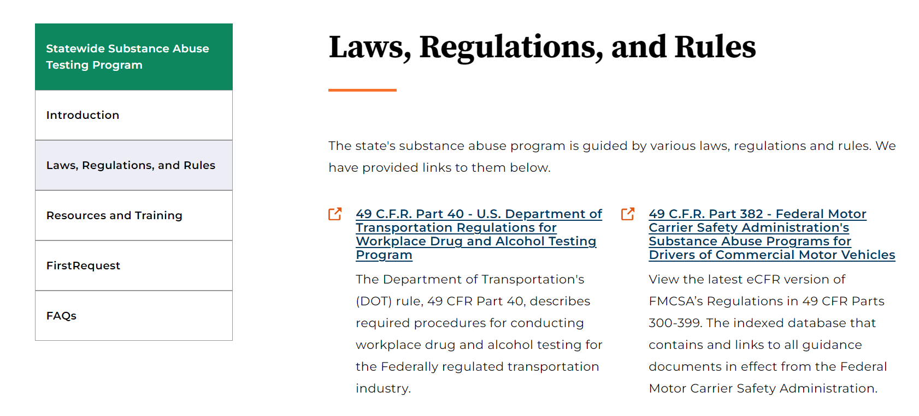
SCHEDULE
PREPARE
DELIVER
September 23rd, 2025
ALIGN
September 9th, 2025
October 1st, 2025
September 1st, 2025
Reference: Substance Abuse Laws, Regulations and Rules | Georgia Department of Administrative Services - DOAS
Notes:
The Federal laws can also be found on the D.O.A.S website – specifically on the Substance Abuse Testing Program page.

Slide 7
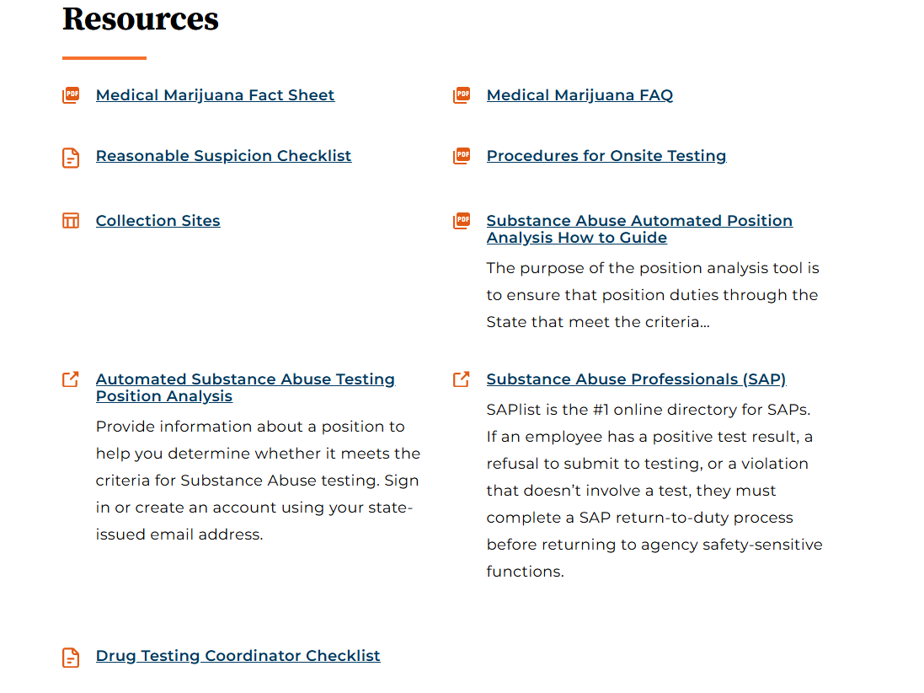
SCHEDULE
PREPARE
DELIVER
September 23rd, 2025
ALIGN
September 9th, 2025
October 1st, 2025
September 1st, 2025
Reference: Resources and Training | Georgia Department of Administrative Services - DOAS
Notes:
Our Substance Abuse Testing Program Page also links to a number of helpful resources and trainings. Some examples of the resources are the Reasonable Suspicion Checklist, the medical marijuana fact sheet, and procedures for onsite testing.

Slide 8
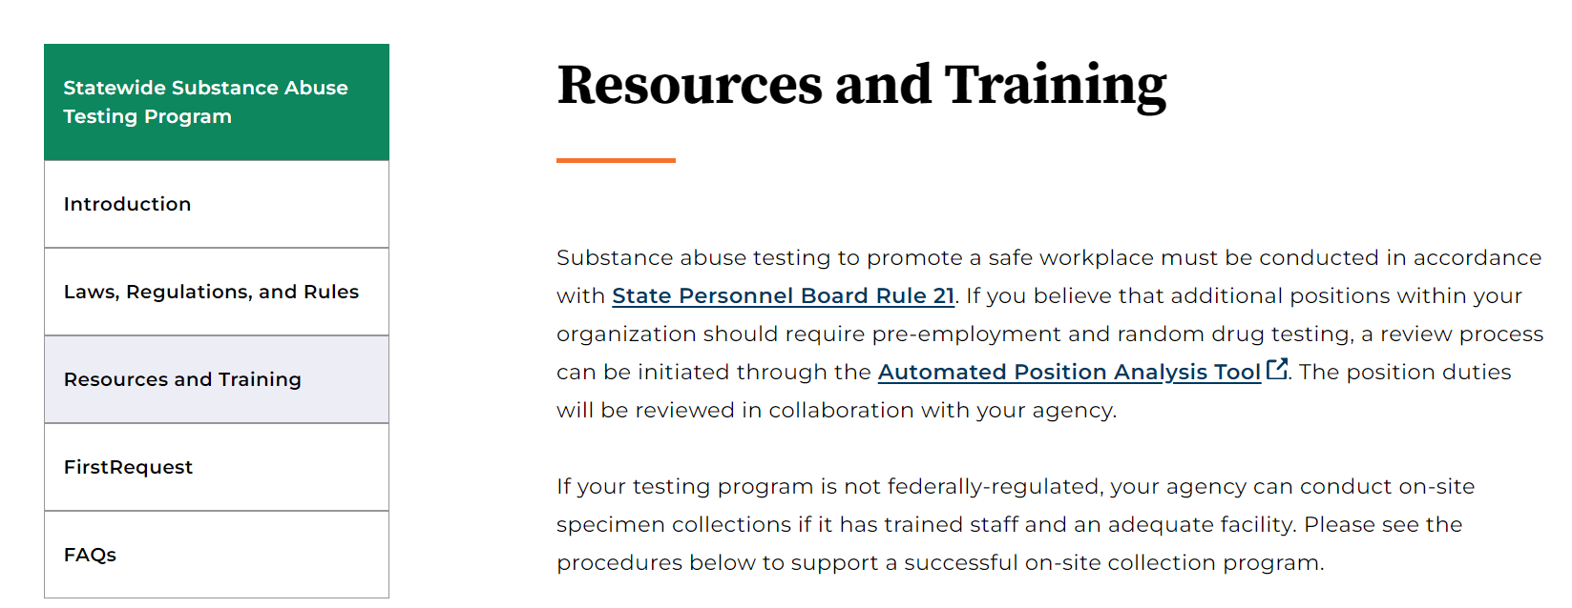
SCHEDULE
PREPARE
DELIVER
September 23rd, 2025
ALIGN
September 9th, 2025
October 1st, 2025
September 1st, 2025
Reference: Resources and Training | Georgia Department of Administrative Services - DOAS
Notes:
Another helpful resource is the Automated Position Analysis Tool, which is also called APAT. We will take a closer look at this resource in the next few slides.

Slide 9
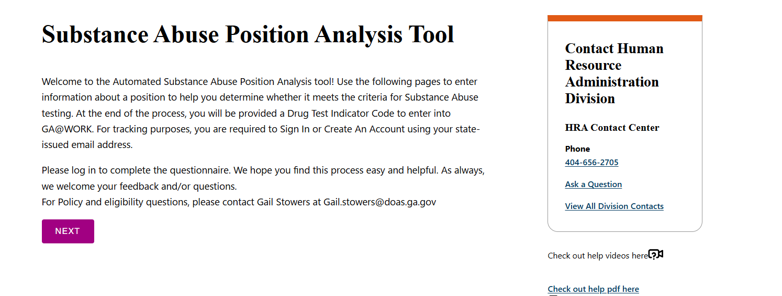
SCHEDULE
PREPARE
DELIVER
September 23rd, 2025
ALIGN
September 9th, 2025
October 1st, 2025
September 1st, 2025
Reference: Substance Abuse Position Analysis
Notes:
This screen shows the welcome page for the position analysis tool. As the text explains, the purpose of the tool is to determine whether a position meets criteria for substance abuse testing. Users will respond to several quick questions when entering the tool. If it is ultimately determined that a position meets criteria for testing, a drug testing indicator code will be provided at the end of the process. The code should then be entered into the human capital management system (or HCM).

Slide 10
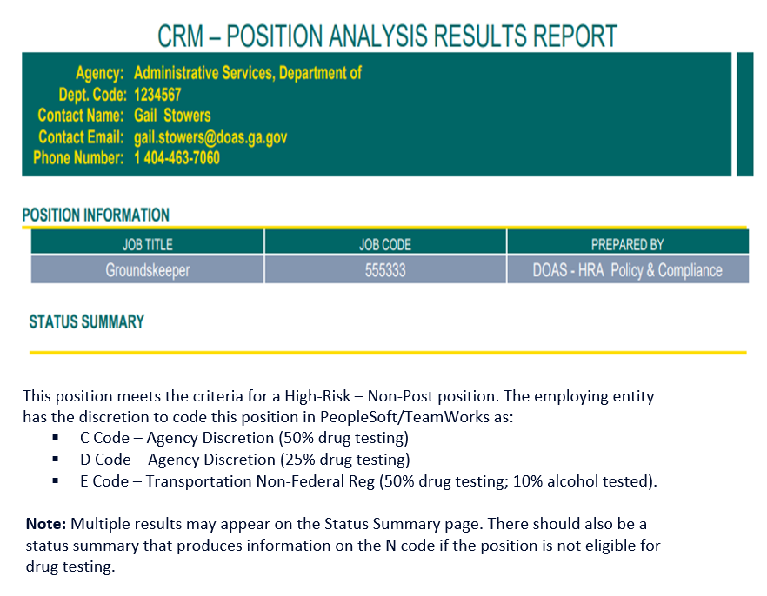
SCHEDULE
PREPARE
DELIVER
September 23rd, 2025
ALIGN
September 9th, 2025
October 1st, 2025
September 1st, 2025
Reference: Substance Abuse Position Analysis
Notes:
This next screen shows the results report that users will see after submitting responses to the questions asked. The report provides the agency name and department code, position information, and also a status summary with possible drug testing codes to use. We will talk more about the codes in the next slide.

Slide 11
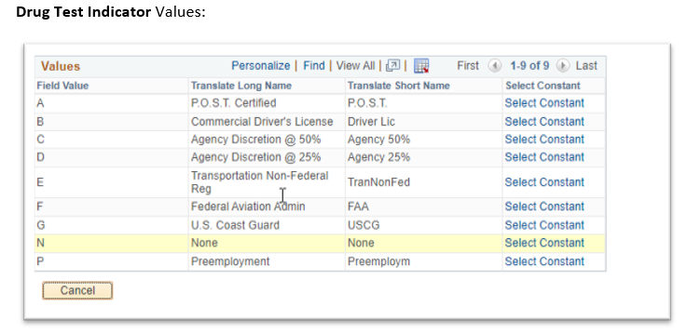
Drug Testing Indicator Page
(in Human Capital Mgmt. system)
SCHEDULE
PREPARE
DELIVER
September 23rd, 2025
ALIGN
September 9th, 2025
October 1st, 2025
September 1st, 2025
Reference: Substance Abuse Position Analysis
Notes:
Here’s an enlarged screenshot of the Drug Testing Indicator page where you’ll select the drug testing code in the HCM. For example, we have code A, which is for all post-certified positions. Not all law enforcement positions require P.O.S.T. certification. Examples of law enforcement positions that do not require P.O.S.T. certification include: Court Baliff, Detention Officers, and Animal Control Officers. Another example is code B, which is for our commercial drivers. The CDL license should also be listed in the HCM. Codes C and D are for our non-DOT High-Risk Positions, and we also have code P, which is used for pre-employment purposes.

Slide 12
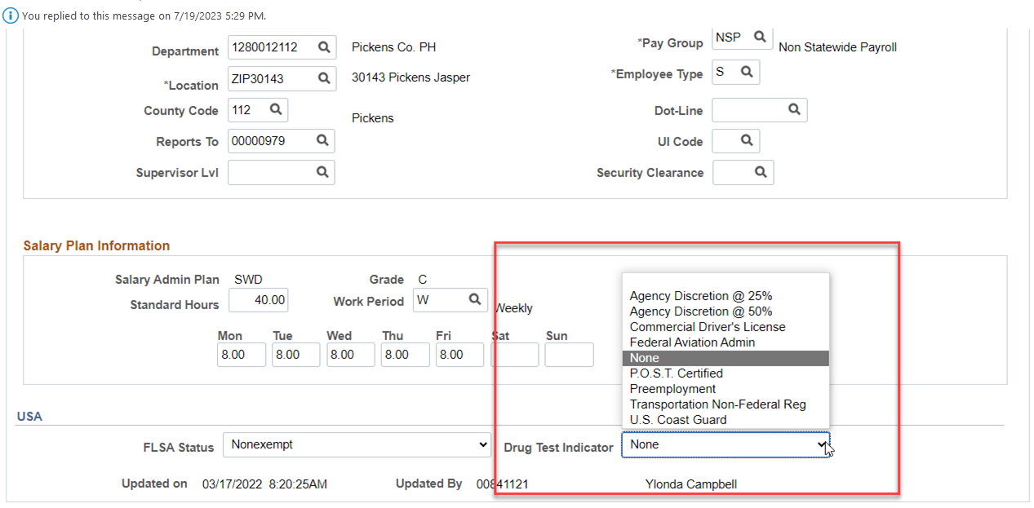




Drug Testing Indicator Code
SCHEDULE
PREPARE
DELIVER
September 23rd, 2025
ALIGN
September 9th, 2025
October 1st, 2025
September 1st, 2025
Reference: Substance Abuse Position Analysis
Notes:
Here's a screenshot of the section where the Drug Testing Indicator Code is located in the HCM. Enter the appropriate code for new positions or existing positions whose duties have changed and are now subject to drug testing. If you have used the position analysis tool, select the code based on what was shown in the results. If a position is not eligible for testing, select “None” in the menu options.

Slide 13

Who’s Eligible for Substance Abuse Testing?
High-Risk Positions (non-DOT)
Federally-Regulated/Safety-Sensitive Positions (DOT)
Notes:
So, who’s eligible for Substance Abuse Testing? Those in high-risk positions and those in safety-sensitive federally regulated positions are eligible for testing.

Slide 14




High-Risk Non-DOT Positions
Performance of High-Risk Work (HRW) pertains to:
      “ …duties to where inattention to duty or errors in judgment by the incumbent while on duty will have the potential for significant risk of harm to the individual or others.”
      Reference: SPB Rule 21
Notes:
As the text on the screen indicates, high-risk positions are those in which being under the influence of alcohol or drugs could create the risk of significant harm to the employee or others. High-risk positions include, but are not limited to, Groundskeepers, Physicians, Nurses, Pharmacists, and Cooks.

Slide 15




Federally-Regulated
(Safety-sensitive) Positions
Any position regulated by the United States Department of Transportation (US DOT).
This Photo by Unknown Author is licensed under CC BY-NC-ND
Notes:
Safety-sensitive positions are regulated by the federal government, specifically the US DOT. Positions regulated by the US DOT include those that require a commercial driver’s license or CDL. Examples include school bus drivers, coast guards, heavy equipment operators, or drivers with the Georgia Regional Transportation Authority (GRTA drivers).

Slide 16
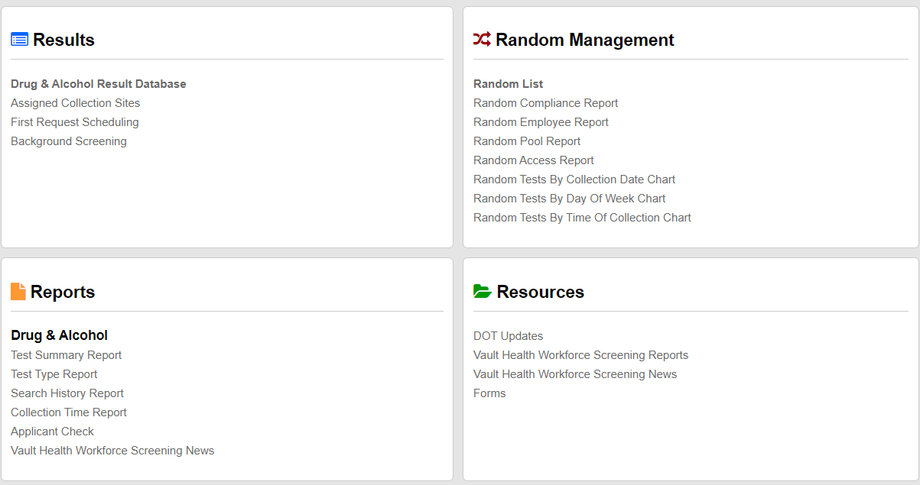
Applicant Verification Portal
Located in the Vault Health Database
Click here for the Applicant Verification Portal Educational Resource:
Applicant Verification Portal (AVP) Training
Notes:
Next, we will discuss the Applicant Verification Portal (or AVP), which can be found in the Vault Health database. The purpose of the AVP is to determine whether or not an applicant has had a positive drug test within the past two years. To view the Applicant Verification Portal Training, please click on the link found at the bottom of the screen.

Slide 17
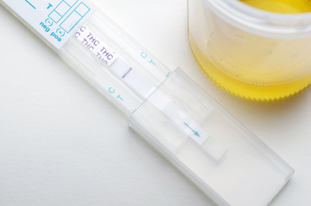
Types of Approved Drug Testing
Pre-Employment
Random
Return-To-Duty
Follow-Up
Post-Accident
Reasonable Suspicion
The only 6 critical programs for state of Georgia
Substance Abuse Testing
Notes:
Georgia law only approves six types of Drug Testing: Pre-employment, Random, Return-to-Duty, Follow-up, Post-Accident and Reasonable Suspicion .

Slide 18

Pre-Employment Testing
Notes:
Pre-employment drug testing is conducted after an offer of employment. This type of testing applies to the following:
- Those offered initial employment into a high-risk or safety-sensitive position
- Current employees transferring into a high-risk position or safety-sensitive position
Whenever possible, pre-employment testing for high risk positions should be completed and a negative result received before employment begins.
For safety-sensitive transportation positions, pre-employment tests must be successfully completed and a negative result received prior to performing the safety-sensitive functions.
More information about pre-employment testing can be found in State Personnel Board sub-rules 21B and 21D.

Slide 19

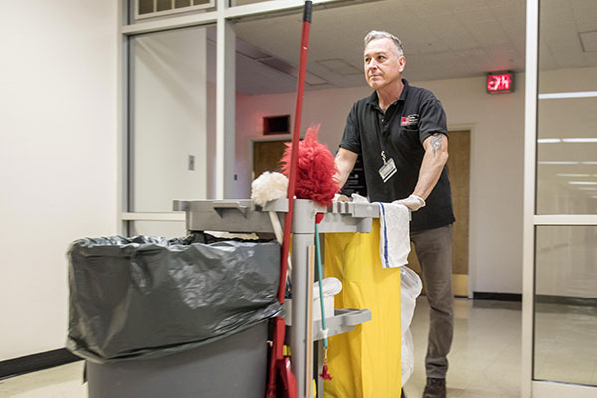

Types of Approved
Drug Testing
Pre-Employment
Random
Return-To-Duty
Follow-Up
Post-Accident
Reasonable Suspicion
The only 6 critical programs for State of Georgia
Substance Abuse Testing
Notes:
Let’s now talk about random testing.
A Random Drug Test occurs when employees working in a High-Risk or federally regulated position are placed in similar pools to be randomized for testing.
The term randomized means that a computer system randomly selects similar positions. Our vendor handles random testing. So, no one knows what positions will be selected for random testing.
In fact, it’s possible that a person may be identified for random testing for two or more months in a row. If an employee is selected more than once, they are required to report for testing again. However, if an employee is assigned a third time, HR will document it in their file, and the employee will not be required to undergo testing unless it is a federally regulated position.

Slide 20
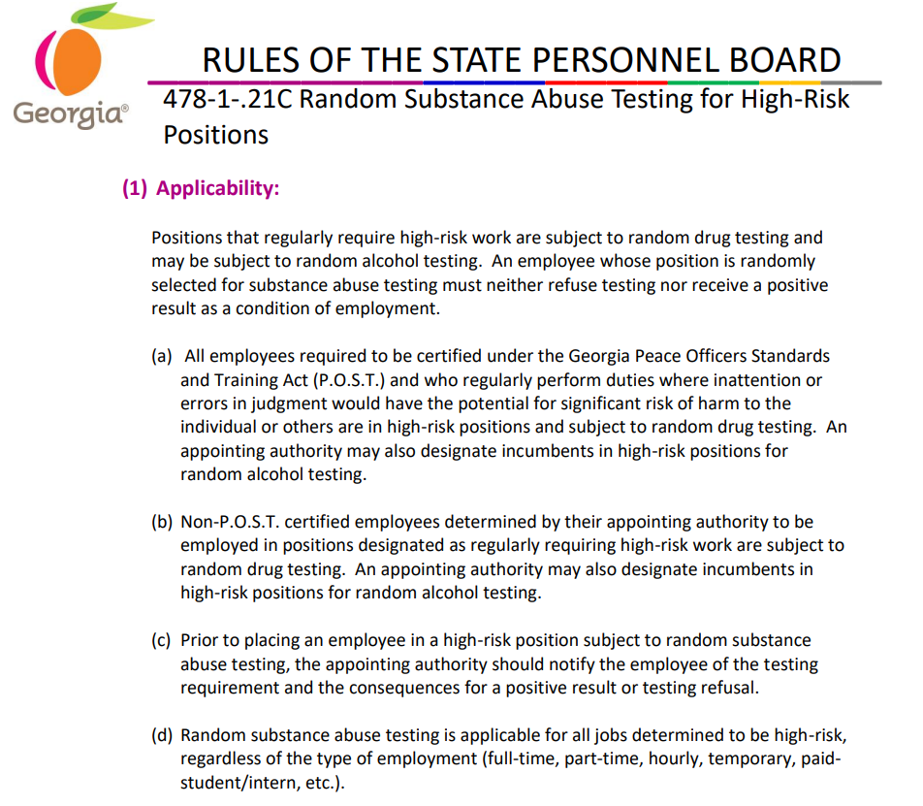
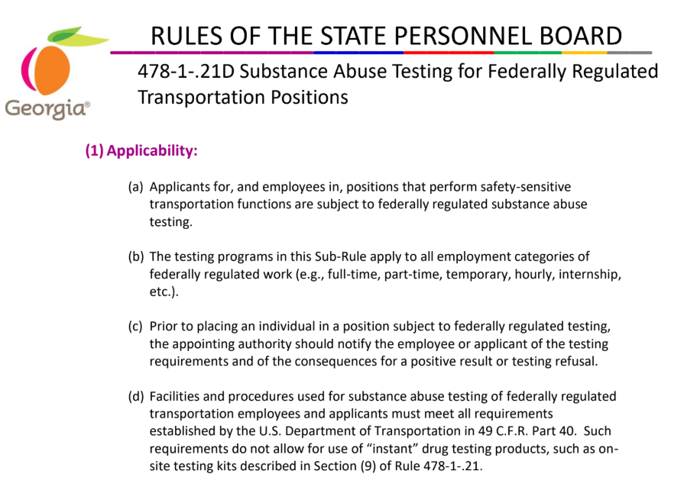
Notes:
State Personnel Board Sub-Rule 21C and 21D require that State of Georgia Employees in High-Risk and Federally-Regulated positions be randomly tested for drugs and alcohol.

Slide 21
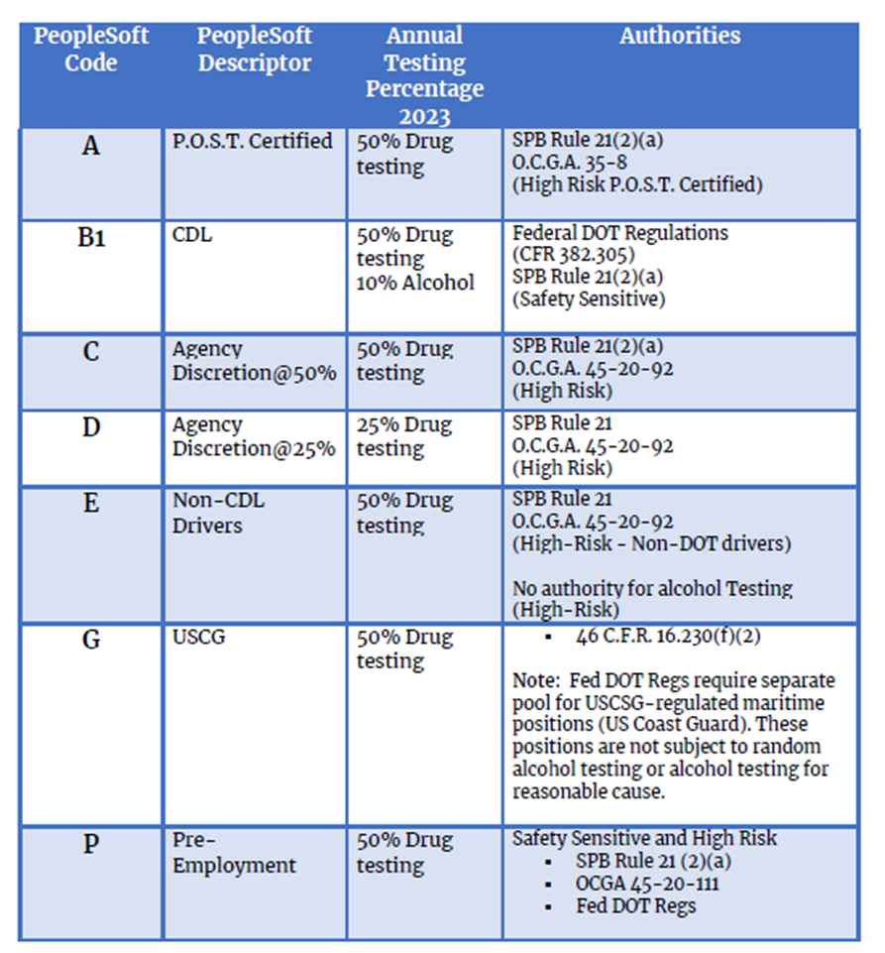
Code Used In HCM System | HCM Descriptor | Annual Testing Percentage | Authorities
Random Testing - Codes
Notes:
Your screen shows the substance abuse testing codes that can be found in the Human Capital Management System or HCM. Positions are identified monthly for random testing through use of the codes. Looking at the first code in the chart, which is Code A, we see that this code is assigned to all law enforcement positions within the state of Georgia that are POST certified. These positions are randomized together, and incumbents of the positions are to be tested annually at 50% regardless of agency.
Looking at the next code in the chart, which is code B, we see that this code is assigned to federally regulated CDL positions. According to the annual testing percentage, incumbents of these positions must be drug tested at 50% annually and 10% annually for alcohol testing.
For codes C and D, which are assigned to high-risk positions, the HCM descriptors indicate that at agency discretion, testing can occur at 50% or 25%. If an agency has a budgetary issue with testing at 50%, we recommend that the agency consider testing at 25%, which would be code D.
Lastly, the fourth column lists the regulations and statutes pertaining to each code.

Slide 22

Self-Disclosure
Notes:
What if an employee came to you and self-disclosed that they had an alcohol or drug problem? As long as the employee has not received notification to be randomly tested, the HR leader can move forward with referring that employee to a substance abuse professional. However, if the employee self-discloses after notification of random testing, they will still have to be sent for random drug testing.
Let’s now take a closer look at this scenario.
The employee has appropriately self-disclosed to the supervisor; the supervisor brings the employee to HR, or the employee goes directly to HR themselves to self-disclose. HR then recommends the employee to a substance abuse professional or SAP, typically through an Employee Assistance Program or EAP.
The SAP then evaluates the employee to determine whether the employee needs treatment through an inpatient or outpatient program.

Slide 23

Return-to-Duty Testing
Notes:
Once the employee has completed their substance abuse treatment program, they will need to take a Return-to-duty drug test before returning to work.
The drug testing results must be negative. Otherwise, the employee will be terminated immediately if the test is positive.

Slide 24


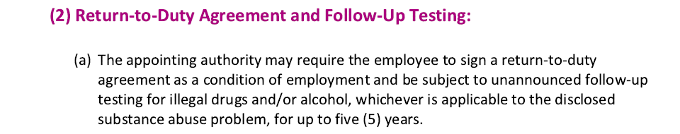
Follow-up Testing
Notes:
Once the employee has re-entered the workplace, the employee will have to sign an acknowledgment to be randomly tested.
The screen shows a copy of State Personnel Board Sub Rule 21A, specifically the second section of the rule, which states the appointing authority may require the employee to sign an agreement and be subject to follow-up drug testing for up to five years. Other sub-rules that cover return to duty and follow-up testing are 21F and 21G.

Slide 25

Post-Accident Testing
This Photo by Unknown Author is licensed under CC BY-SA
Notes:
Next, employees performing safety-sensitive transportation functions involved in an on-the-job accident may be required to undergo substance abuse testing. Such testing shall be conducted and ordered as soon as possible. Compliance with this testing, in accordance with all applicable federal regulations, is a condition of employment. Sub-rule 21-D provides a post-accident testing requirement chart for reference and guidance on handling post-accident testing.

Slide 26

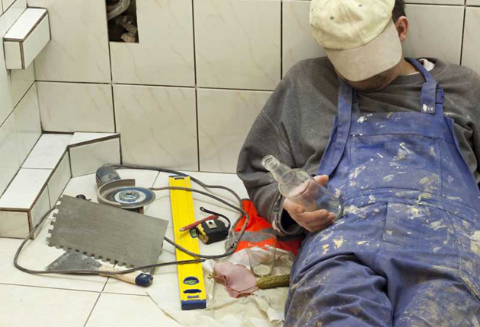
Reasonable Suspicion Testing
Notes:
The last type of testing is reasonable suspicion testing. Reasonable suspicion drug or alcohol testing of an employee occurs when a designated agency or entity official determines that there is a compelling reason to suspect an employee is not free from alcohol or drugs. The designated official may be a manager, supervisor, human resources representative, or other agency or entity staff assigned responsibility for determining whether reasonable suspicion exists.

Slide 27
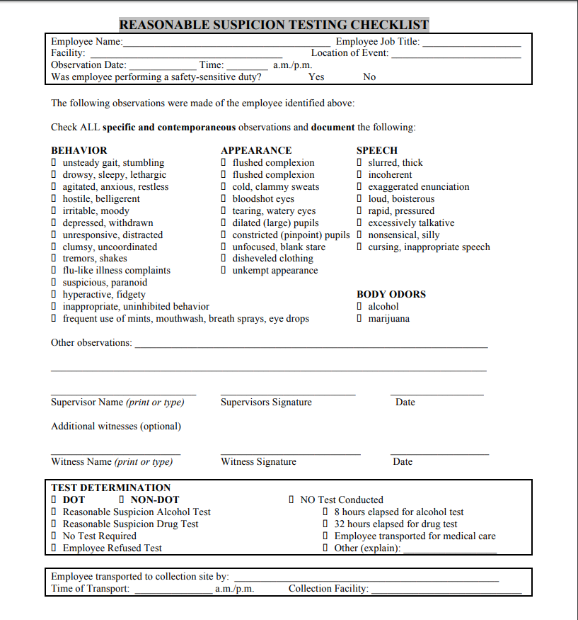
Reasonable Suspicion Testing
Reference: Reasonable Suspicion Checklist (Final).docx
Notes:
In incidents involving reasonable suspicion, this office encourages HR to provide the Reasonable Suspicion Checklist to the employee’s supervisor or other leader who directly observed the indicators pointing to possible drug use. This checklist can be found at the link listed on the slide.

Slide 28

Issues That May Arise at the Collection Site
Notes:
In this slide, we’ll now touch on some of the issues that can arise at the collection site. One of the issues that may arise is the employee may indicate that they need to leave before testing is complete. To give a specific scenario: An employee is transported to a collection site with the supervisor, arriving at 3 PM. It’s 5 PM, and the employee mentions that she received a call to pick up her child. If the employee leaves or steps outside of the collection site before the required three hours, the nurse at the collection site will note that the employee left. Leaving could be considered a refusal by your agency, leading to termination. Know that once the employee arrives at the collection site, they are not permitted to leave the site until they have provided a specimen.

Slide 29

Issues That May Arise at the Collection Site
Notes:
To touch on another issue: What if the supervisor must leave the collection site before the required three-hour timeframe? In this scenario, the employee will have to remain at the collection site to produce a specimen within those 3 hours. It is important that agencies have a policy that indicates whether or not supervisors are expected to remain at the collection site for the entire time. Such a policy should be shared with all supervisors within each agency.

Slide 30

Other Issues That May Arise at the Collection Site
Notes:
Now, If the employee has been at the site for a total of three hours and hasn't been able to produce a specimen after the nurse has given the employee up to 16 oz of water to drink, the nurse at the collection site will then make a notation on the chain of custody form and indicate a possible shy bladder issue. Shy bladder may occur for medical reasons such as an employee being on dialysis or having kidney failure and ultimately being unable to produce a specimen in the allotted time.

Slide 31

Issues That May Arise
Notes:
Following incidents such as the one described, the medical review officer or MRO will contact the agency to see if the agency wants to move forward with sending this employee to a shy bladder specialist. The agency may decide against referring the employee for additional testing, as it would be responsible for the cost.. However, if they choose to move forward with testing, a method other than urine testing, such as blood or saliva testing, will be used. The test most commonly provided by shy bladder specialists is the blood test.

Slide 32
Thank you!
Please email us at: Policy@doas.ga.gov
Martha Allen
Statewide Drug Testing Coordinator
HRA – Policy 404-657-4277
Martha.Allen@doas.ga.gov
Gail Stowers
Statewide Drug Testing Coordinator
HRA – Policy 404-463-7060
Gail.Stowers@doas.ga.gov
Notes:
Thank You! This concludes the Onboarding educational resource. If you have questions or need further assistance, please contact the HR-Policy unit or one of the Policy Analysts listed on the screen.

